Slide 1
Weekly Scheduler
Created by: Stacie & Mark
With assistance from: Fanny

Slide 2
Our Project
Allows users to create events by day
Can select and manage other users calendars (good for families)
Editable events

Slide 3
Challenges
The whole project
Massaging the data
Populating dates
Connecting User & Events with an id

Slide 4
Triumphs
Combining Mark’s user model
Refactoring the code to adjust events to the user model
Completing the MVP
Finishing the project!

Slide 5
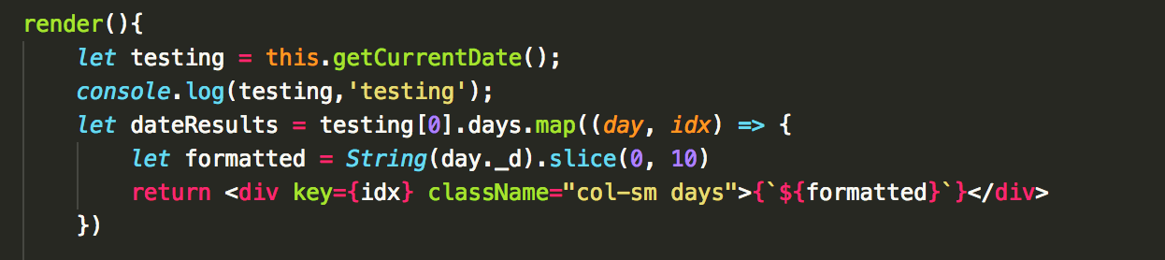
Outstanding Code

Slide 6
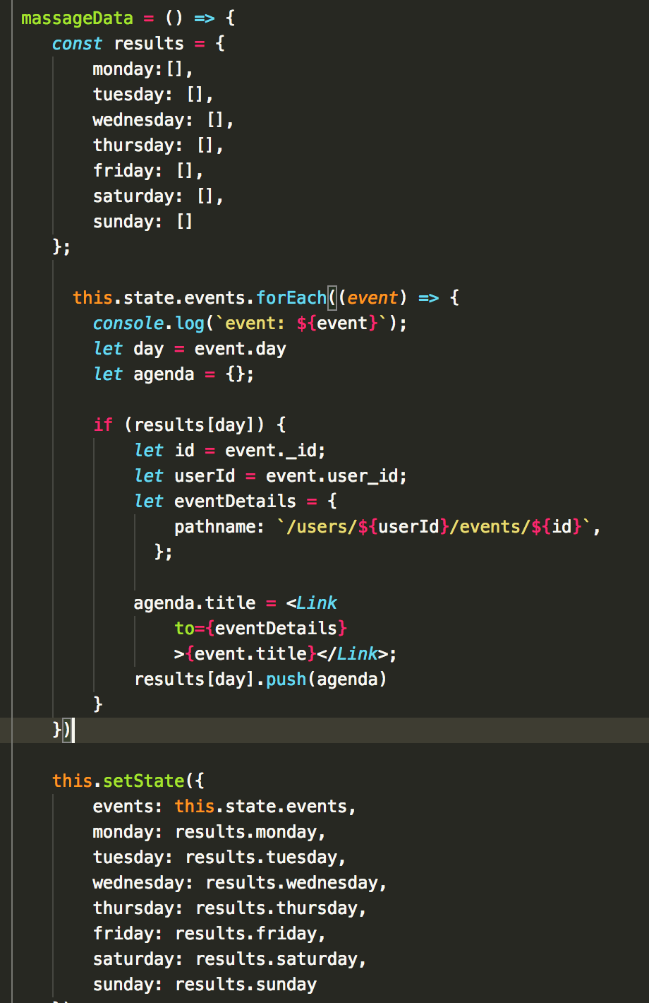
Outstanding Code

Slide 7
If I had more time….
Validate the input fields to only take real days
Implement time to prioritize events
Be able to switch to prev. and future week views
Alerts and reoccurring events

Slide 8
Shoutouts
Thank you Fanny
Thanks to Jacob for helping research Moment.js
Thanks to the class for the emotional support
Thanks to Michal for providing excellent deployment instructions

